Slide 1
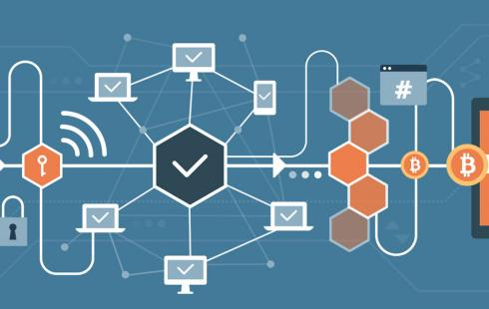
Blockchain Technology
LIE-Jepsen 1.9
Simon Fraipont

Slide 2
BlockWhut?
At its core : Chain of blocks that contains information
1991 → Scott Stornetta & Stuart Haber “How To Timestamp a Digital Document” in Journal of Cryptology
Idea : Make backdating and tampering impossible

Slide 3
“If we can’t tell an old document from a new document, or a tampered one from an original, we’re going to be in real trouble as a society.
And so, I realized there was going to be a need to create tamper-proof, immutable records in the digits themselves.”
- Scott Stornetta

Slide 4
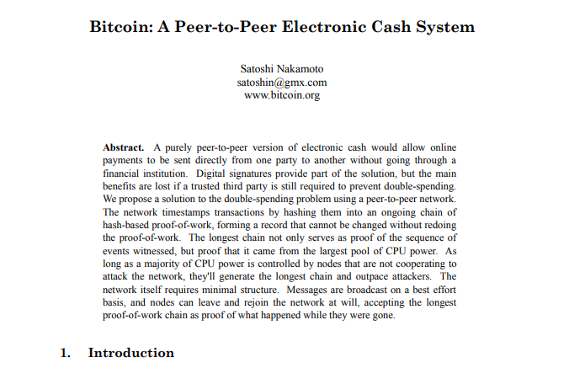
2008 → Satoshi Nakamoto : White Paper
Blockchain remained mostly unused until it was adopted as the underlying architecture of Bitcoin → 2009

Slide 5
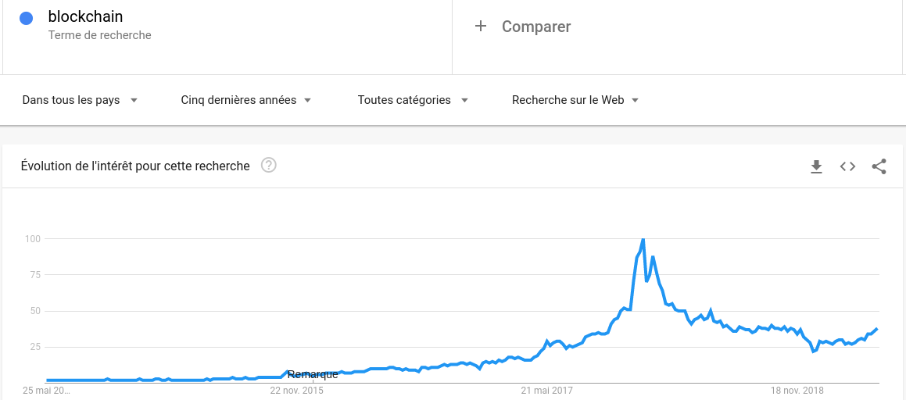
17 December 2017
Global craze , your tech-illiterate grandMother has learned about Bitcoin and Blockchain.
1 Bitcoin = $19,783.06

Slide 6
The Data Structure
Block composition:
    Timestamp
    Data (depends on the type of blockchain)
    Hash of the block (fingerprint)
    Hash of previous block
Blocks are linked by these hashes, “chained” together

Slide 7
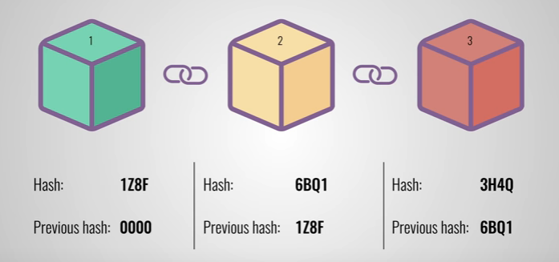
The Data Structure

Slide 8
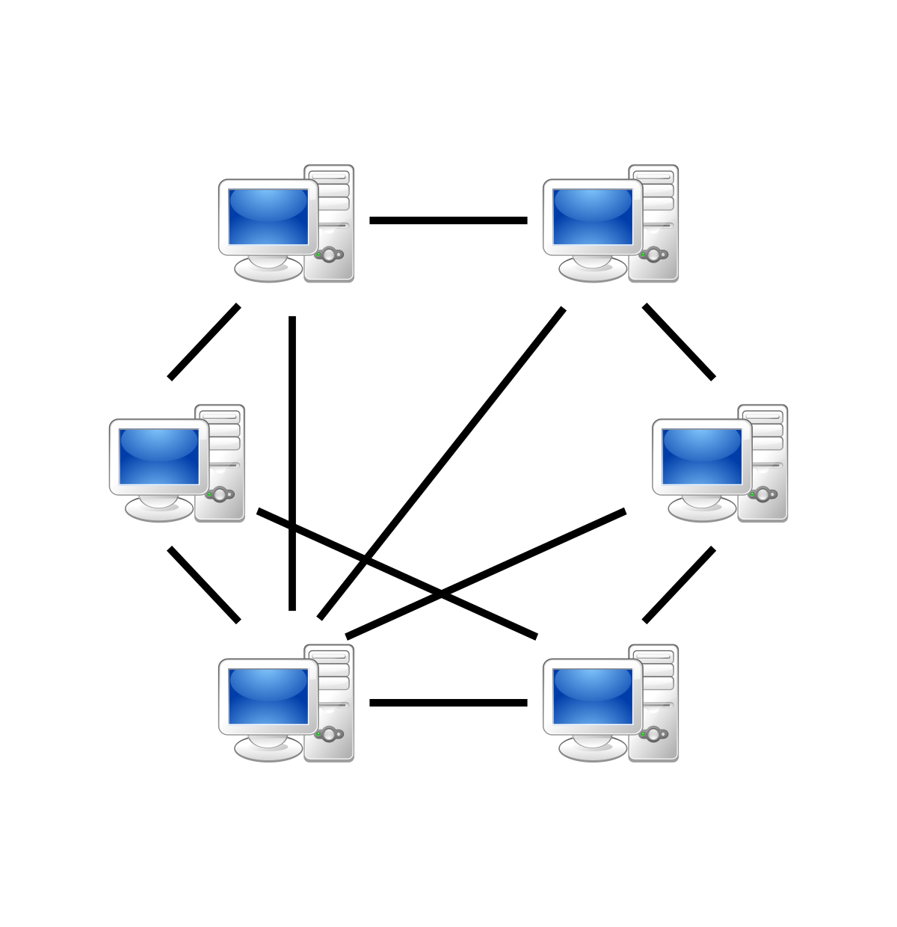
A Decentralized, Distributed Network
P2P system
No central authority, behavior is the result of the aggregate of the decision of the individual nodes
Every node communicates its results to other nodes to reach a result

Slide 9
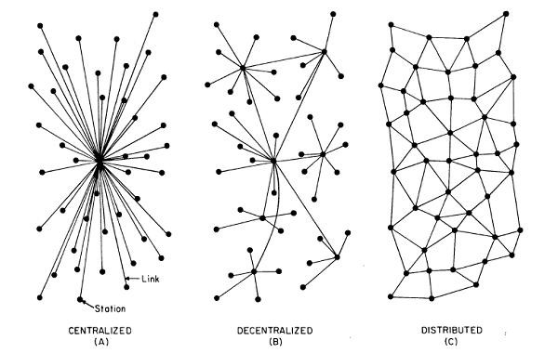
A Decentralized, Distributed Network

Slide 10
The Underlying Idea
Provide a system where records can be stored, facts can be verified by anyone and security is guaranteed.
Said system is persistant, transparent, public, and append-only.
Evolution of how we interact and trade. Societal impact

Slide 11
What makes this interesting?
Once data has been recorded inside a block, it’s incredibly difficult to tamper with
Trust is built in, a consensus has to be reached by all the nodes
Hash usage (change in the block means change in the hash)
Proof of work
Everyone can join the network, receive a copy of the entire ledger and participate in its integrity

Slide 12
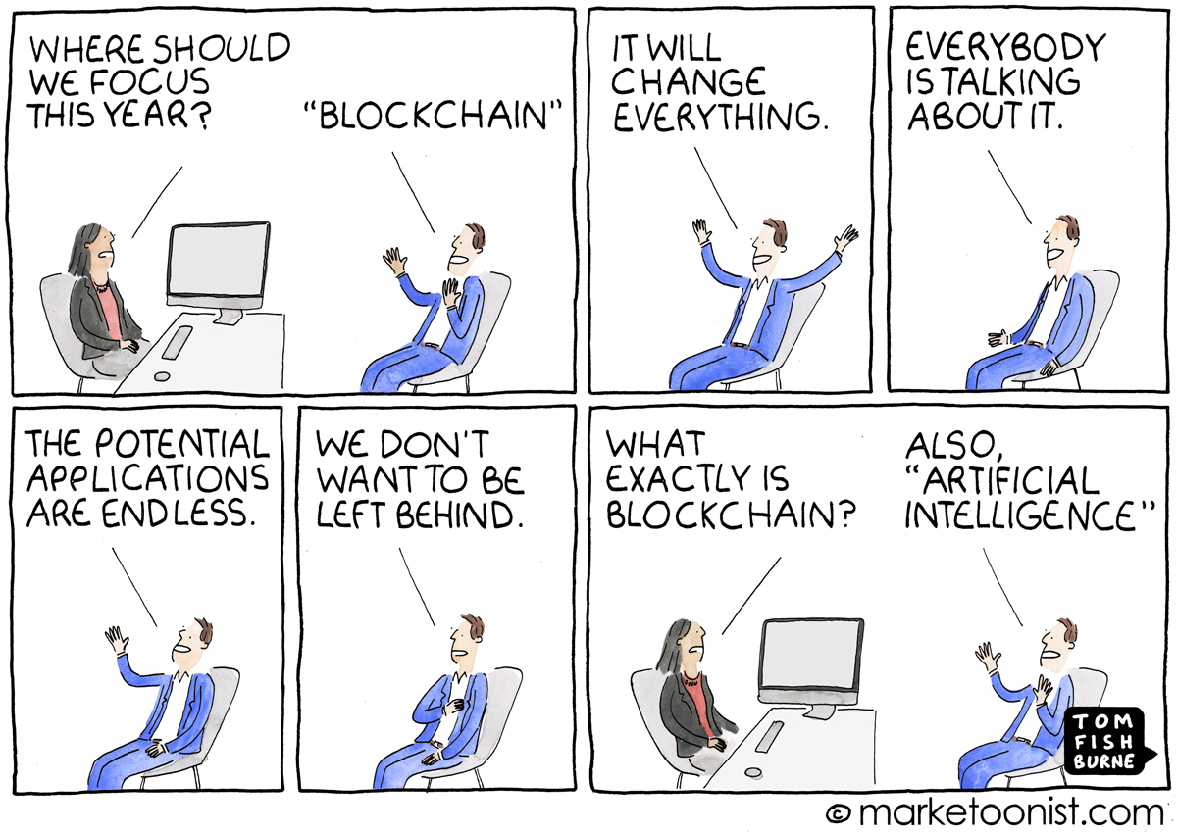
What Impact?
This could help us go from an “internet of information” to an “internet of value”.
Every industry where a “trusted third party” is vital could be overhauled.
Booming industry, hard to predict.

Slide 13
What Impact?
Banking
Supply chain management
Insurance
Internet of Things
Energy management
Government
Voting
Healthcare
charity
Online music
Crowdfunding
Retail
Real estate

Slide 14
Limitations and Potential Issues
Current environmental cost (PoW)
Buzzword, bubble phenomenon
Complexity for end users to conceive theoretical benefits
Lack of regulations → risky environment
“Revolutionary” status, means establishment pushes back (I.e banks)

Slide 15

